Slide 1
ROS ACTION
21AIE213 - Robot Operating System and Robot Simulation

Slide 2
Previous Section
ROS Service
Turtlesim ROS Service
Creating ROS Service
Example Service Creation
Implementing a Service
Creating a Server
Creating a Client

Slide 3
Section Overview
ROS Action
Turtlesim Action Service
Defining an Action
Example ROS Action
Implementing ROS Action Service
Creating a Action Server
Creating a Action Client

Slide 4
ROS Action
ROS services, which are useful for synchronous request/response interactions.
Services are handy for simple get/set interactions like querying status and managing configuration, they don’t work well when you need to initiate a long-running task.
For example, imagine commanding a robot to drive to some distant location; call it goto_position . The robot will require significant time to do so.
The exact amount of time impossible to know in advance, since obstacles may arise that result in a longer path.
Client will be blocked until a response comes

Slide 5
ROS Action
ROS actions are the best way to implement interfaces to time-extended, goal-oriented behaviours like goto_position.
While services are synchronous, actions are asynchronous.
Similar to the request and response of a service, an action uses a goal to initiate a behaviour and sends a result when the behavior is complete.
But the action further uses feedback to provide updates on the behaviours' progress toward the goal and also allows for goals to be cancelled.
Actions are themselves implemented using topics. An action is essentially a higher-level protocol that specifies how a set of topics (goal, result, feedback, etc.) should be used in combination.

Slide 6
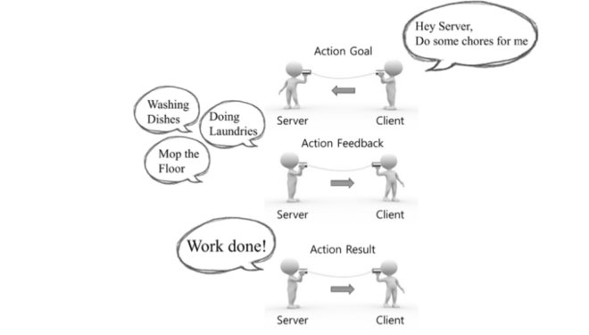
ROS Action
Image Courtesy: Prof. Anis koubaa

Slide 7
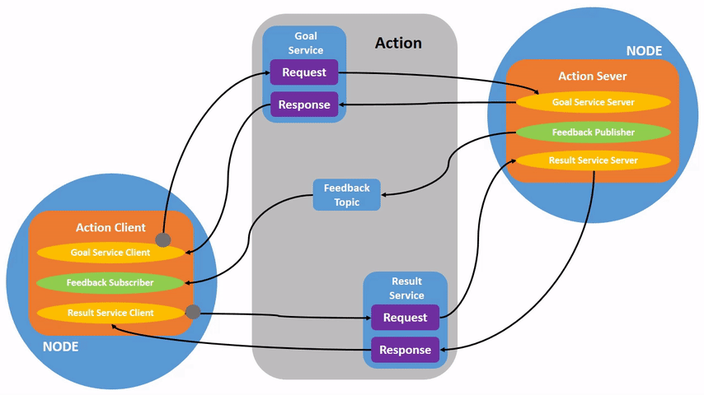
ROS Action

Slide 8
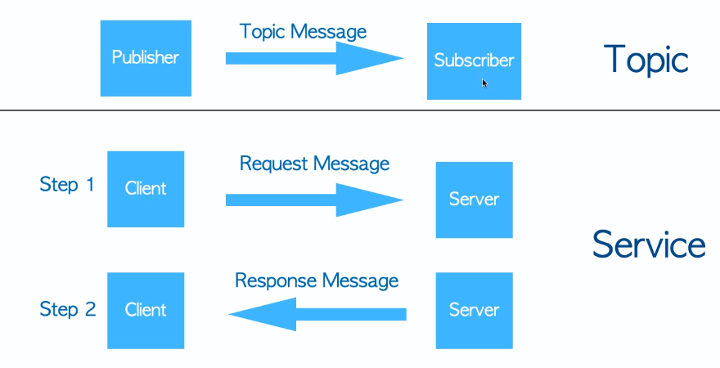
ROS Action
Action Client
Goal
Action Server
ActionLib
Action Client
Feedback
Action Server
Action Client
Result
Action Server

Slide 9
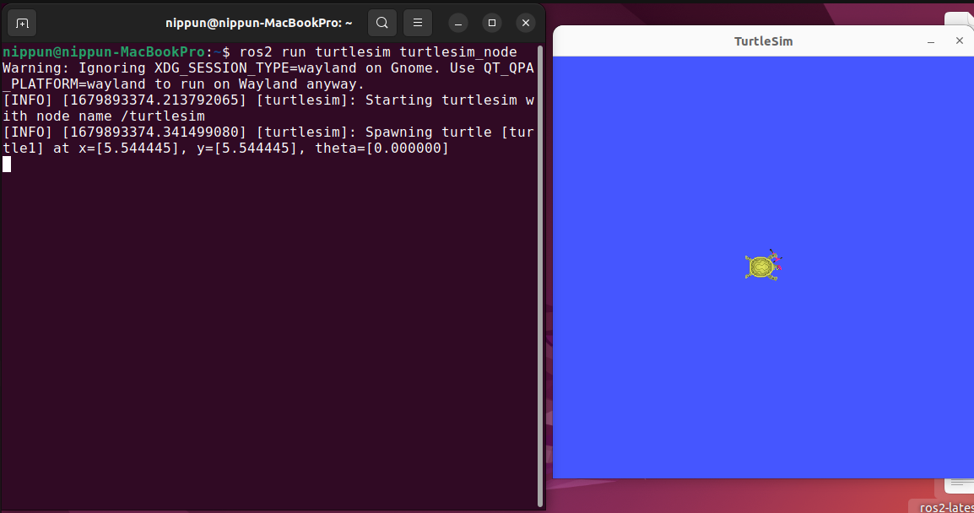
Turtlesim Action Service

Slide 10
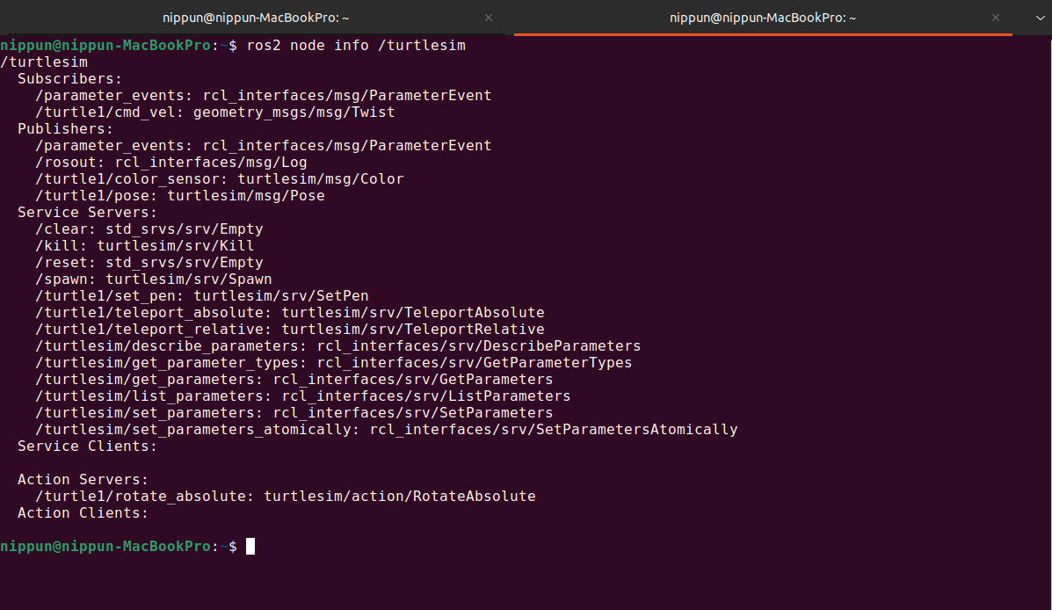
Listing actions

Slide 11
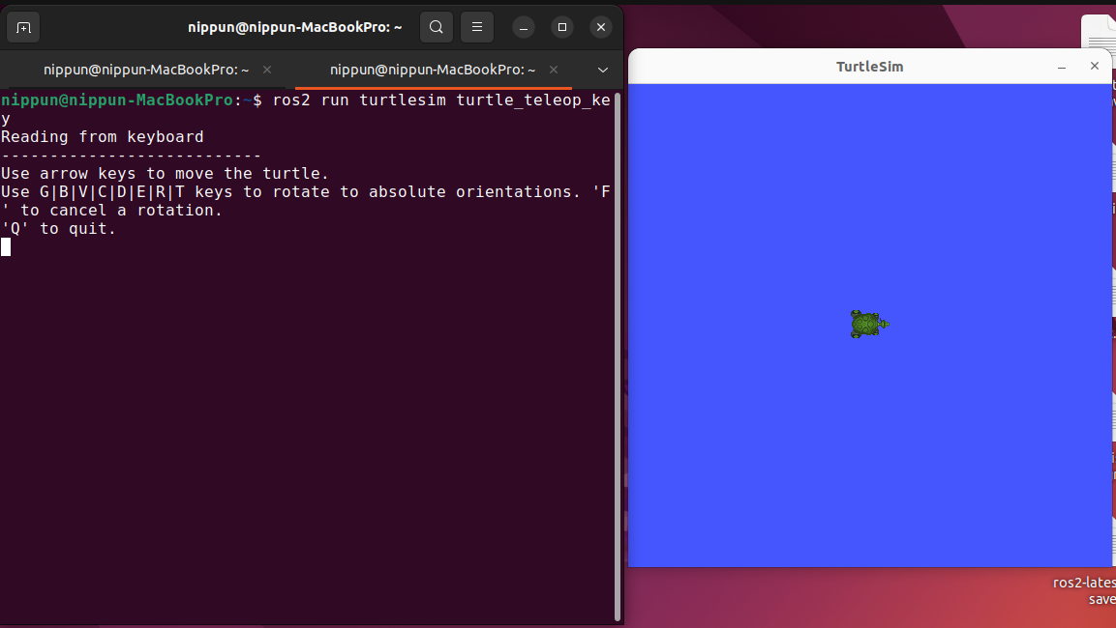
Running teleop node

Slide 12
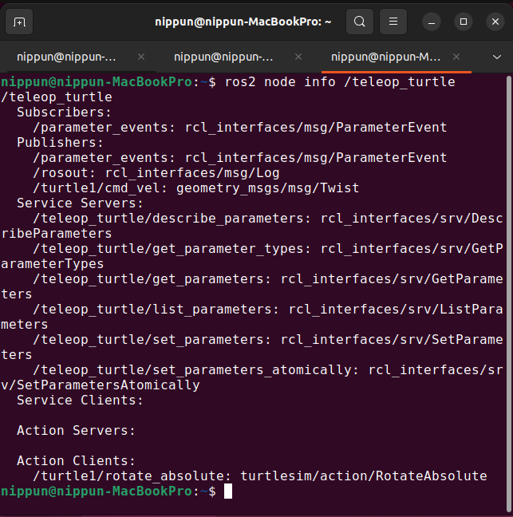
Listing actions in teleop node

Slide 13
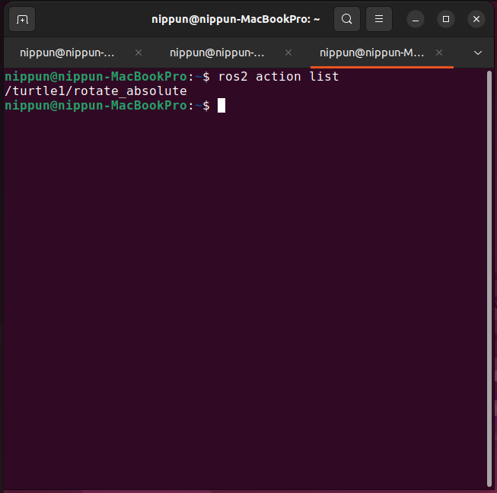
Listing action

Slide 14
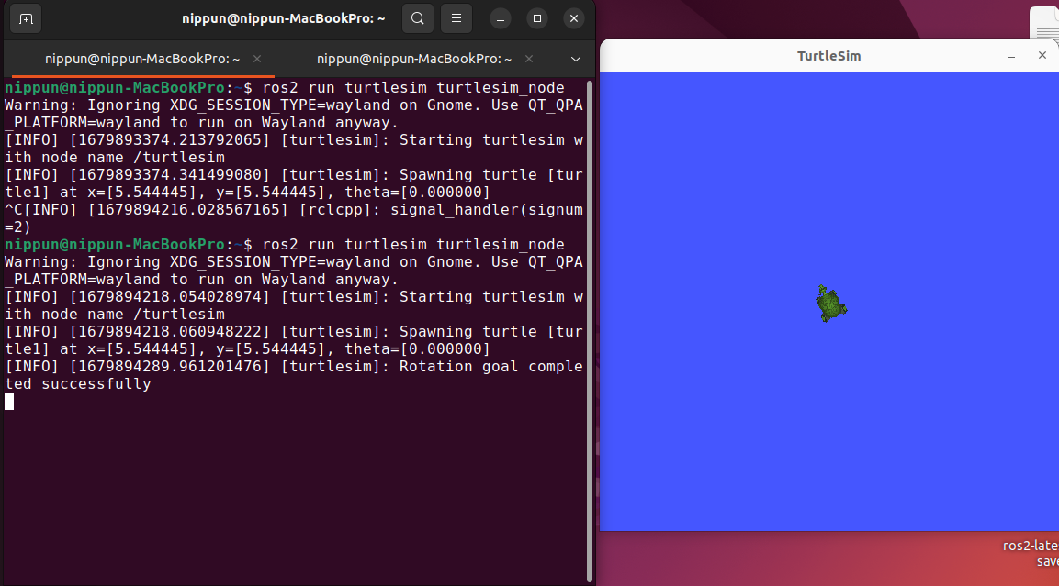
Sending action request

Slide 15
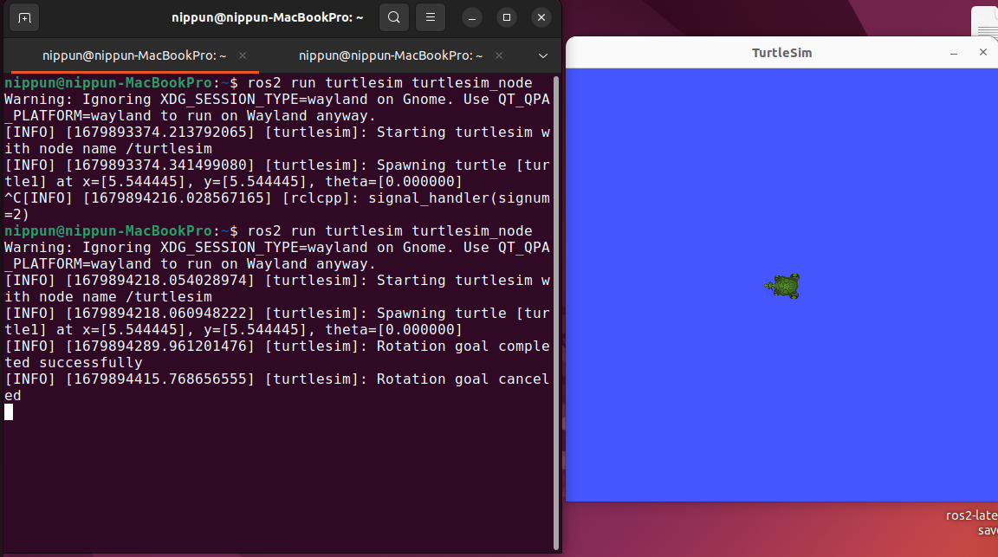
Cancelling action

Slide 16
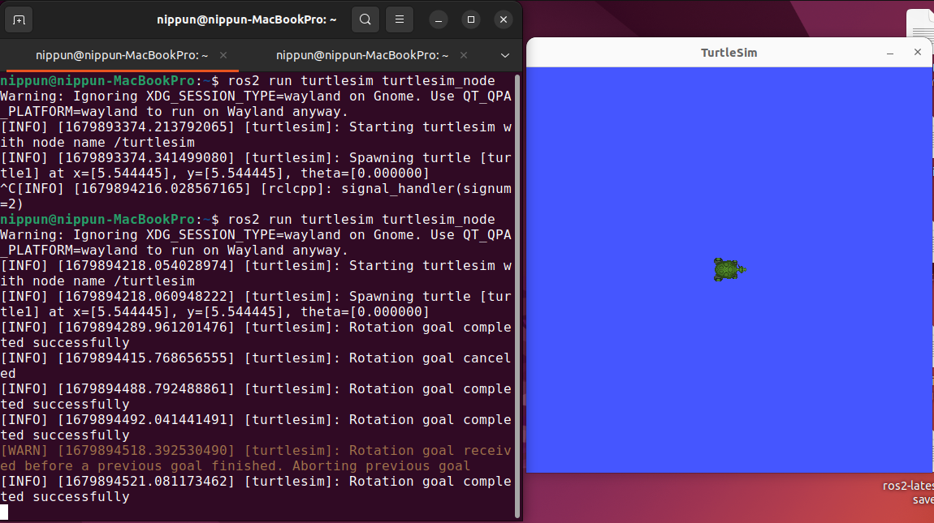
Aborting action

Slide 17
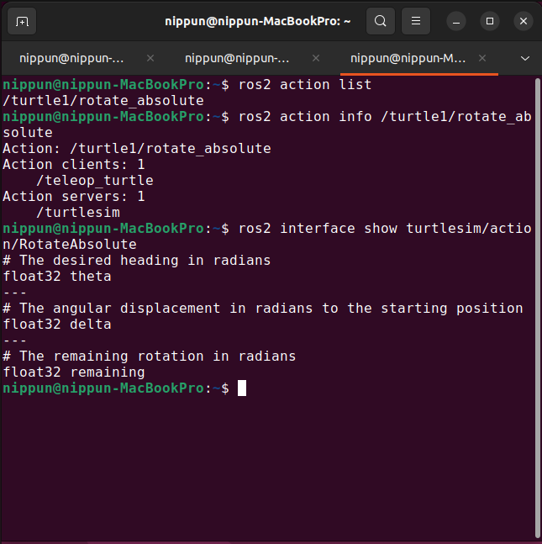
Action data type

Slide 18
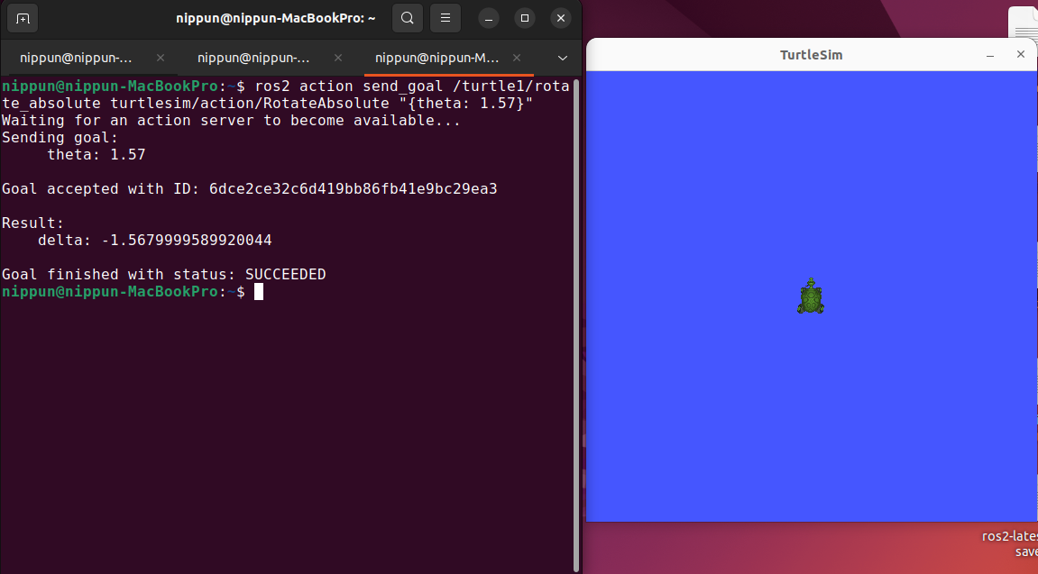
Command Line Action Client

Slide 19
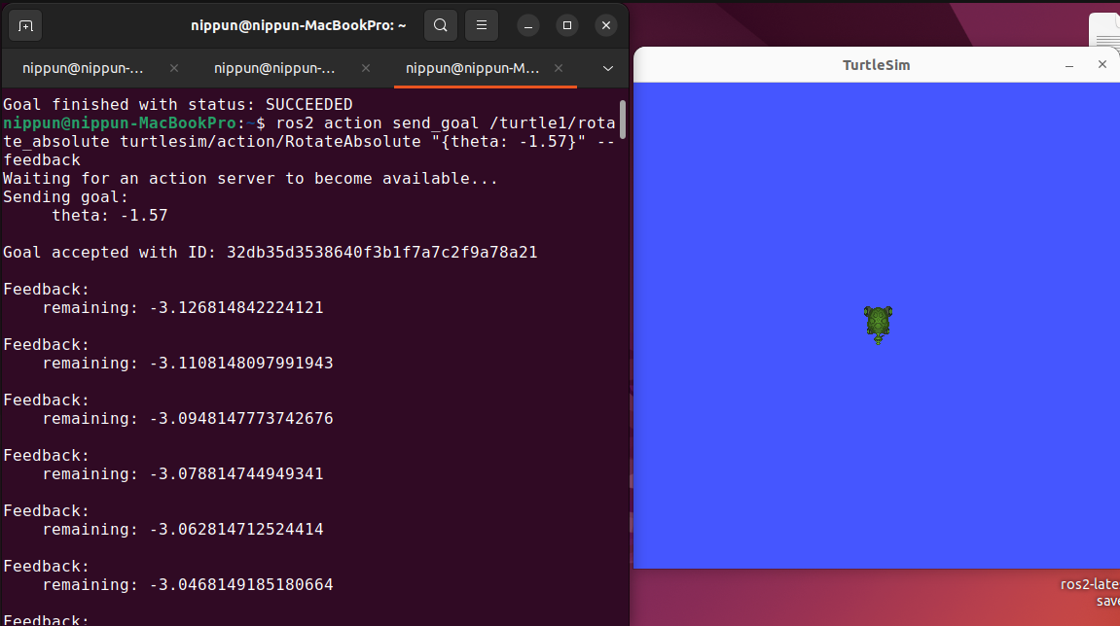
COMMAND LINE ACTION CLIENT with feedback

Slide 20
Defining an Action
Five Steps to Define New ROS Action
1. Create a new folder named "action" in root of the package
2. Inside action folder create a new action file named "ActionName.action"
3. Define the new action in the action file
4. Update CMakeList.txt and package.xml file to compile the new action into language-specific implementations
Build the package and Source the devel/setup.bash file

Slide 21
ROS Action Format
ActionName.action​
GoalType1 GoalFieldName1​
GoalType2 GoalFieldName2​
---​
ResultType1 ResultFieldName1
ResultType2 ResultFieldName2
---
FeedbackType1 FeedbackFieldName1
FeedbackType2 FeedbackFieldName2
​

Slide 22
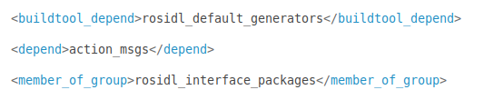
Compiling the Service
Before compiling the new service, changes have to be made in CMakeList.txt and package.xml files to make catkin identify the new message
In package.xml file, add the below lines

Slide 23
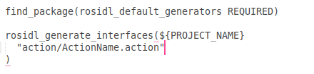
COMPILING THE Service
In CMakeList.txt file do the following changes
Go to the root of your catkin workspace, and build the package
Type command : source catkin_workspace/devel/setup.bash
Will create new message named Your_Service, Your_ServiceRequest and Your_ServiceResponce

Slide 24
Example ROS Action
Fibonacci action
This action gives us the Fibonacci series given the order
Along the way, it should tell us periodically the intermediate series
When it’s done, it should tell us full series

Slide 25
EXAMPLE Action CREATION
Create a package named "fibonacci_action_interface" and a sub directory named action
Store Fibonacci.action file in the action directory.
Change the configuration files accordingly
Build the package and source the devel/setup.bash
Create a new package named "fibonacci_server_client" and write a python server and client for the Fibonacci action
Change the setup.py file to enter the starting point

Slide 26
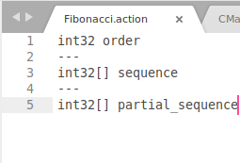
Fibonacci Action – Action Format

Slide 27
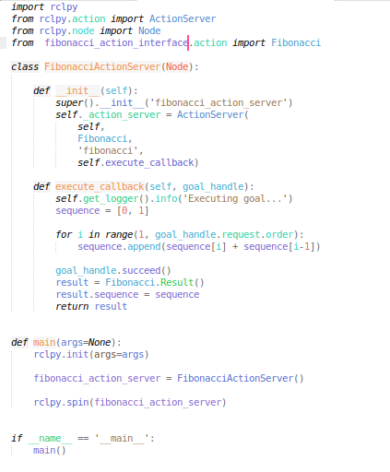
Fibonacci Action - Server

Slide 28
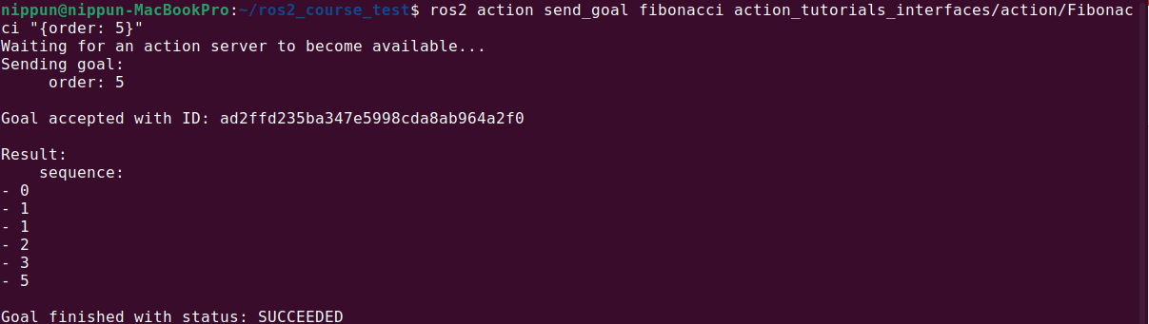
FIBONACCI ACTIOn SERVER– cHECKING

Slide 29
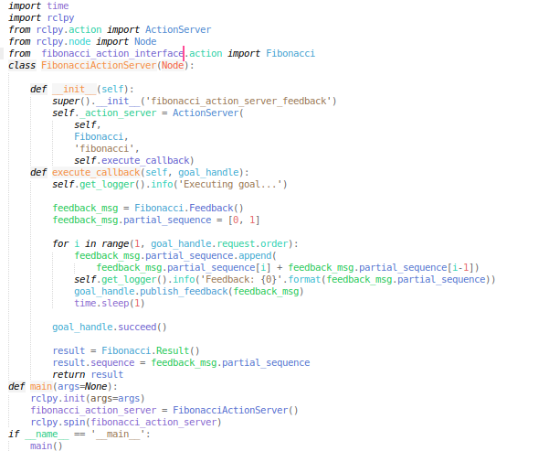
FIBONACCI ACTION – SERVER Feedback

Slide 30
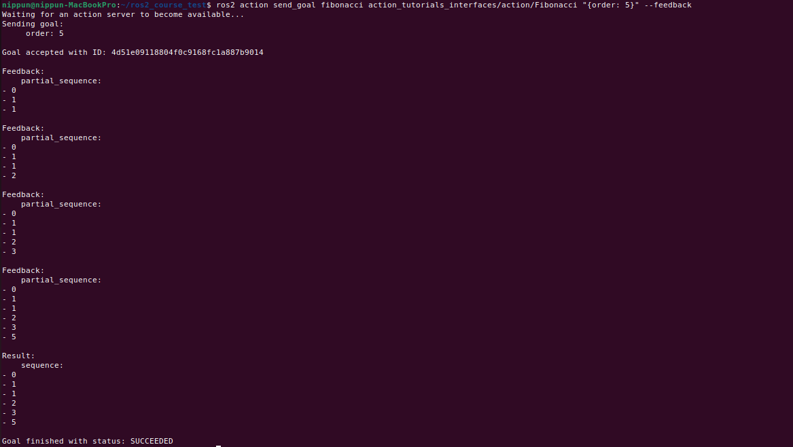
FIBONACCI ACTION SERVER Feedback – CHECKING

Slide 31
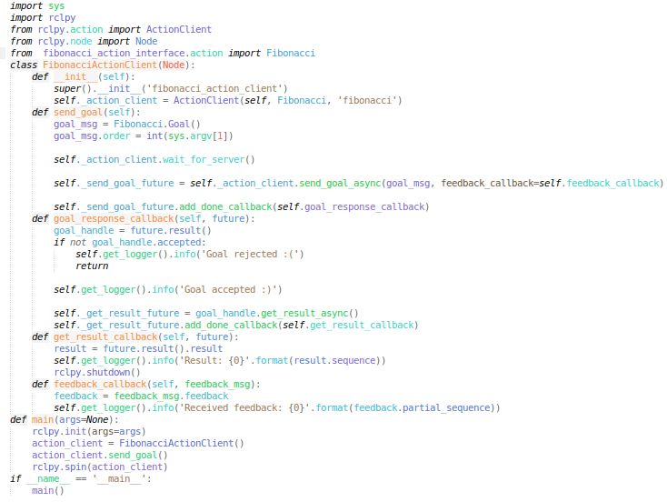
FIBONACCI ACTION – Client

Slide 32
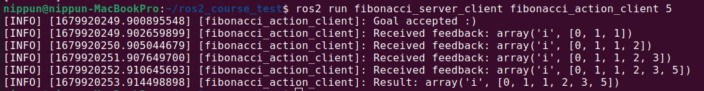
FIBONACCI ACTION CLIENT- Output

Slide 33
Thank You !!!

